Slide 1
WORKERS EMPLOYMENT
BY:-
Gagan kumar kaira-160117737092
Prashanth gopathi-160117737101

Slide 2
aBSTRACT
It is an online website project. It contains all the information about workers who are available near to location of customer and who are ready for home service on customer’s request.
This project is build using HTML, JavaScript, Python in frontend and Mysql database in backend.
Service Receivers need to register to website by contacting the admin and submitting their details.

Slide 3
Introduction
This project helps the customer to find their required service nearer to them.
It also helps workers to find their earning according to service they provide.
Service Receiver is requested to create an account and login to the website to search and Workers need to register to website by contacting the admin and submitting their details.

Slide 4
Problem statement
. It is a burden for workers to search for work on daily basis. Once in the morning session if he/she doesn’t get work then the whole day they should waste their time and they can’t earn money and livelihood maybe difficult for them to survive. This issue is being faced by many workers now-a-days.

Slide 5
Requirements
Software:
Operating System : Window XP, Windows
Front –End : HTML, Java Script, PHP
Back-End : PHP, MYSQL Supporting
Server : Apache Tomcat 5.5 , XAMPP Server
Hardware
Processor : Intel Pentium IV,2.4 GHz
RAM : 512 MB
Hard Disk Drive : 40 GB

Slide 6
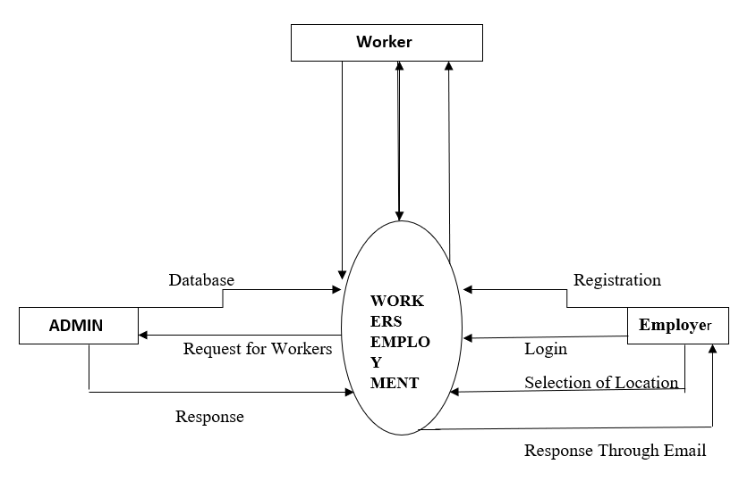
Flow chart

Slide 7

SCREEN SHOTS

Slide 8
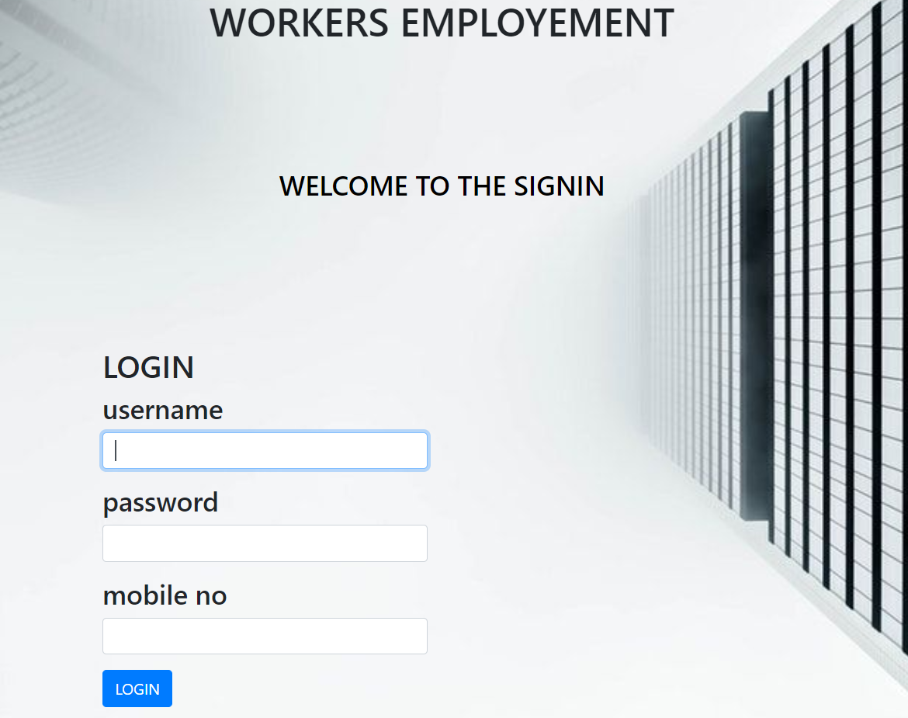
Signin page

Slide 9
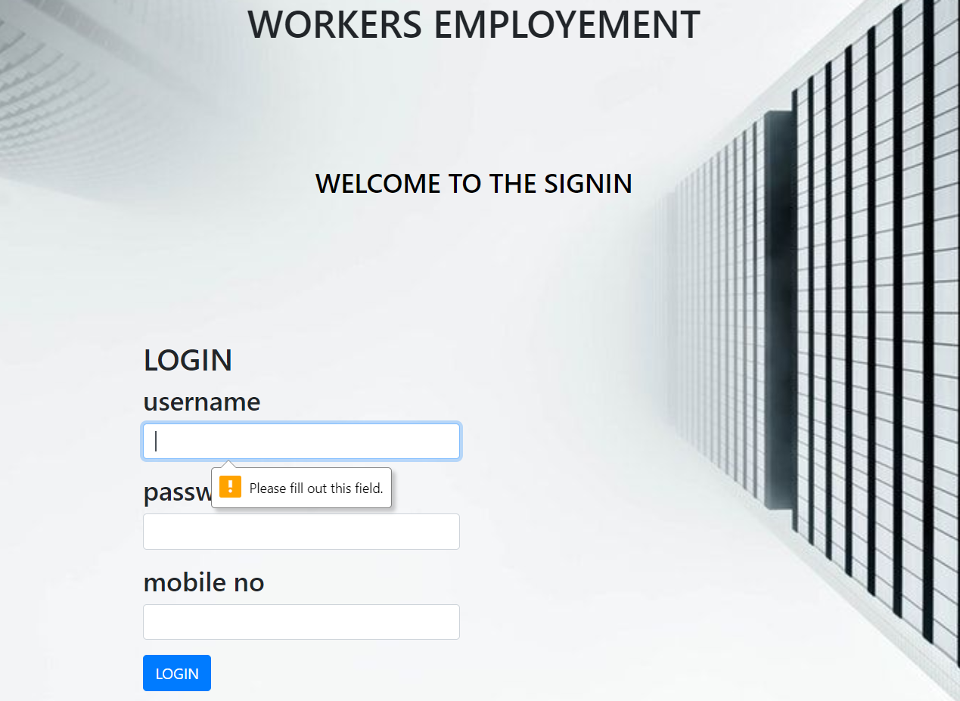
Signin error

Slide 10
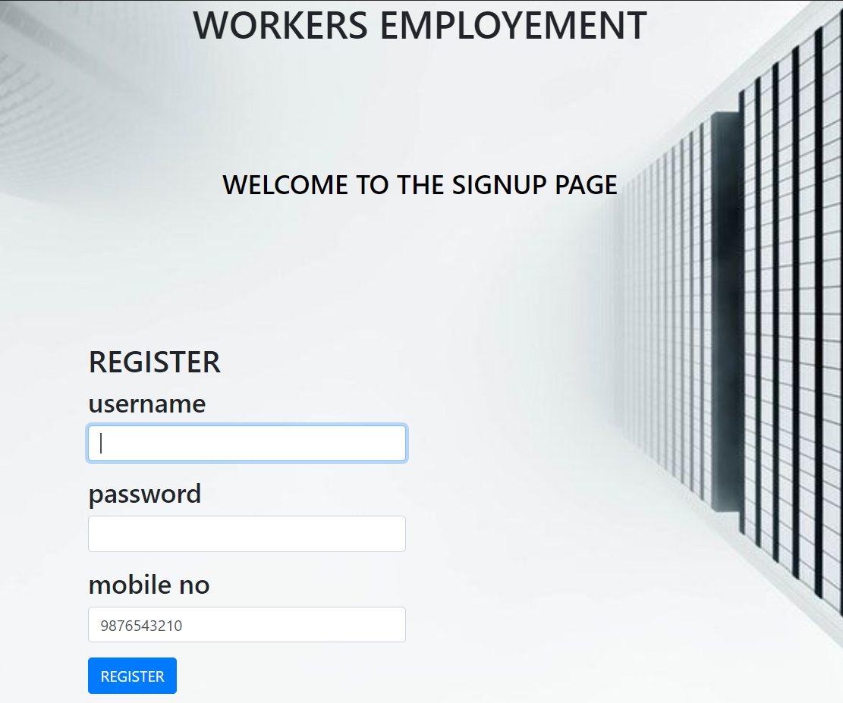
Registration page

Slide 11
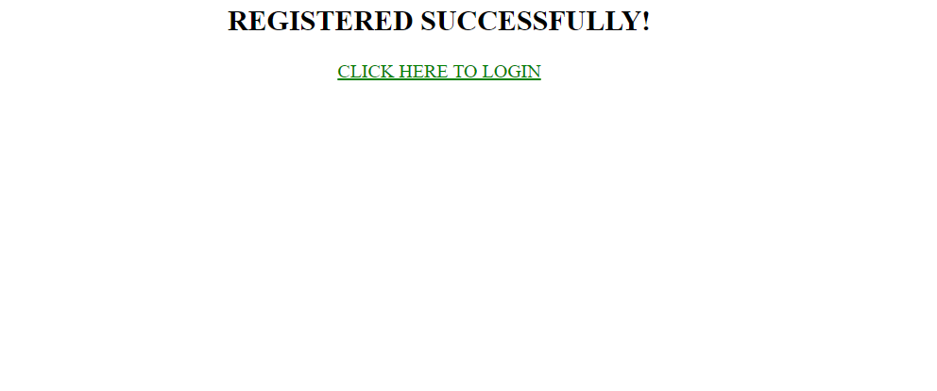
Successful registration

Slide 12

Location of work

Slide 13
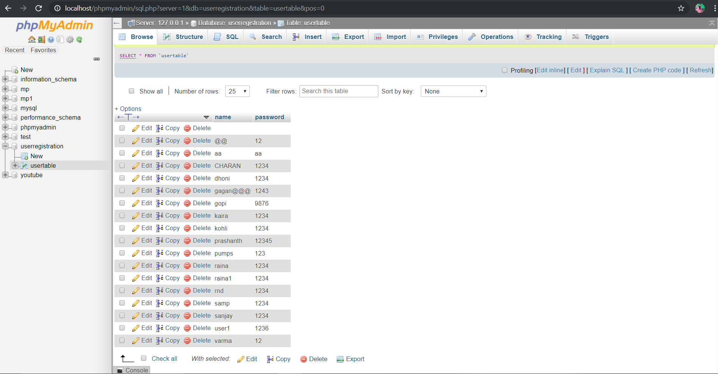
database

Slide 14
Future scope
This project basically developed mainly in the view of workers who work on daily basis.
This can be implemented and developed across all forms of employment.
Admin and worker interface shall be maintained for better progress of the website.

Slide 15
conclusion
By the end of the project ,we create a platform in between service provider and service receiver.
And we can provide work for the workers.

Slide 16
THANK YOU

